Slide 1
Introduction to Python for Social Sciences
Iftach Amir, PhD

Slide 2
Basic Information
Course name: Introduction to Python for Social Sciences
Time: Thursdays, 1230 - 1500
Instructors: Iftach Amir
Email: iftach.amir@gmail.com
Consult. hours: Flexible, arrange through mail

Slide 3
Goals:
Learn basic concepts in programming
Develop skills to (continue) learning by yourself from on-line resources and examples
Develop confidence to continue working with Python for *your* specific research needs.

Slide 4
Goals:
Familiarity with Python

Slide 5

Why should I learn Python (as a researcher)?
(or why is my department making me learn this?)

Slide 6
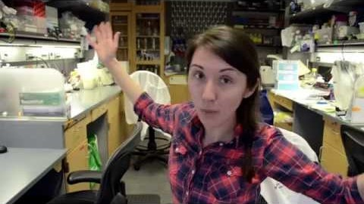

Slide 7
Why should I learn Python?
“The difficult part of learning to program lies with the fundamentals”
“once a researcher has those nailed down, adapting to a new language is just a matter of syntax.”
“What matters most in the early stages is having a good support network.”
“Pick the programming language based on what people around you are using,”
Increasingly, that language is Python.”
(link)

Slide 8
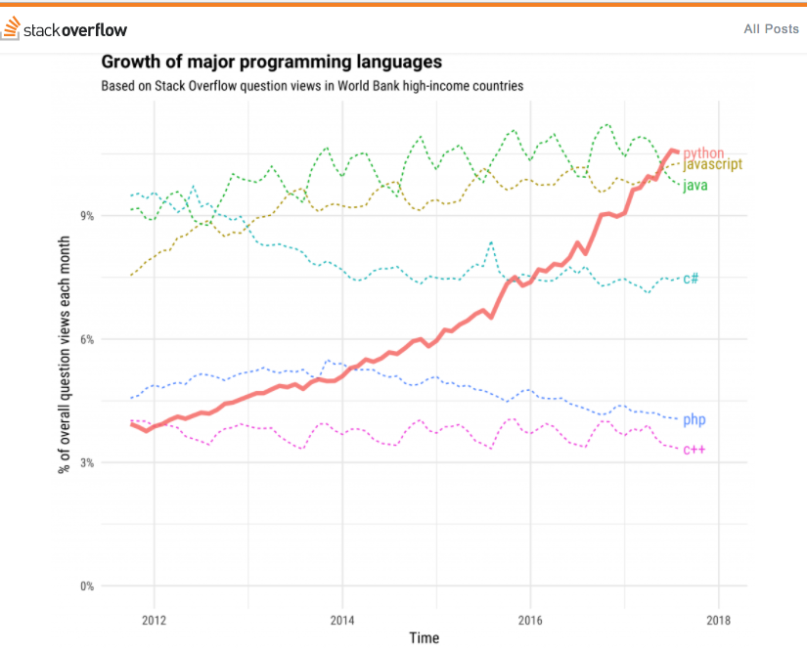

Slide 9
What are we going to learn?
Variables, conditions, recursions
Building functions and modules
Soft “skills”
Self-learning
How to ask a question on-line
Building and experiment in PsychoPy

Slide 10
(Again) What I'd like you to take away from this course:
Be familiar with Python (don't have to be an expert straight away!)
Have an understanding how to learn by yourself from documentation and on-line resources
Feel confident with the basic concepts and skills of programming – then translate that to other languages (R, C, JavaScript) if needed

Slide 11
Course requirements:
Attend and participate.
Complete readings and assignments before class.
End of course project.

Slide 12
Let’s get started

Slide 13
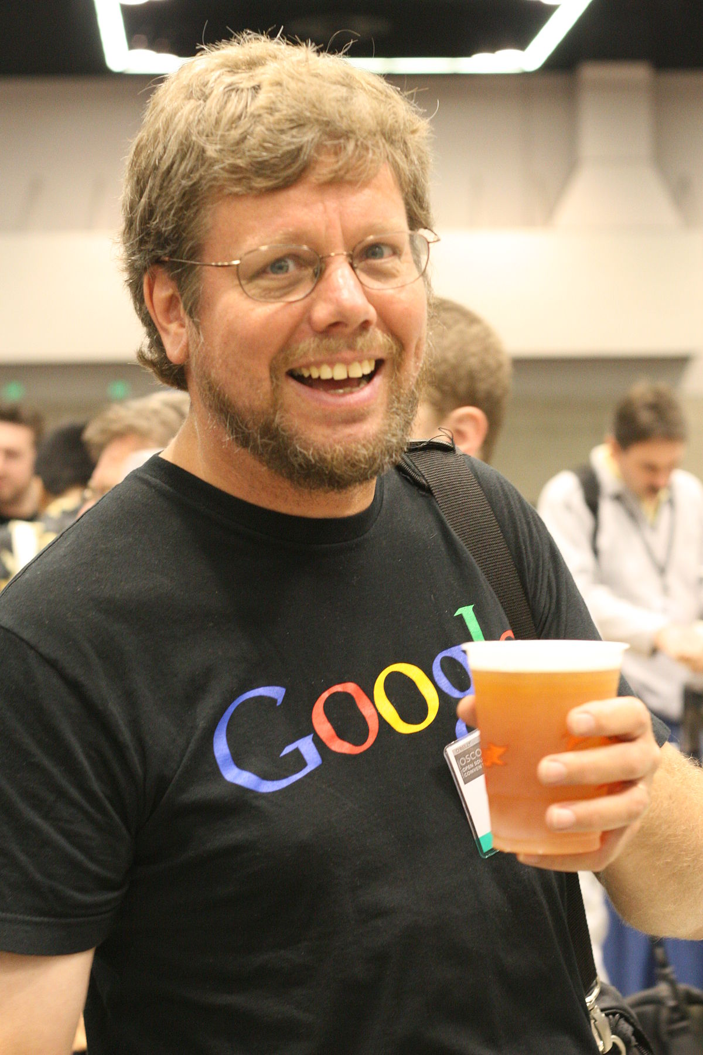

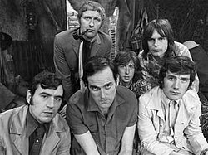

Slide 14

Video #1

Slide 15
print()

Slide 16
print()
print(“Hello world”)
parentheses
(function input)
function name

Slide 17
print()
print(“Hello world”)
Syntax errors
Runtime errors

Slide 18
print()
print(5)
print(5+5)

Slide 19
Operators
A symbol that performs an operation on two inputs / variables, e.g.:
+
-
=

Slide 20
Basic math operations
also here

Slide 21

REPL
Read Evaluate Print Loop

Slide 22
Open repl.it and create an account

Slide 23
Script window
Interactive window

Slide 24
Open repl.it →
0.1. “Basic math operators”

Slide 25
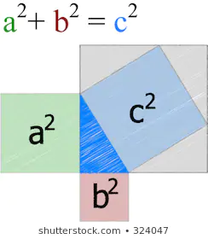
Variables and Assignments
What is a variable?
What is an assignment?
What is a valid variable name?

Slide 26
Variables and Assignments
What is a variable?

Slide 27
Variables and Assignments
What is an assignment?
X = 4
X ← 4

Slide 28
Variables and Assignments
What is a valid variable name?
Can’t start with a number
Can’t be a keyword ‘reserved’ for Python, e.g.:
return
global
Remember to give it a short, meaningful name
Use “_” character if you want to use more than one word
Variable names are case sensitive (small / capital letters)

Slide 29
Keep your code readable
Give your variables descriptive names (better than short names)
Use “ _ “ to separate words in variable name

Slide 30
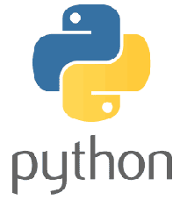
Variables and Assignments
Multiple assignment:
variable1, variable2 = value1, value2
x, y, z = 1, 2, 3

Slide 31
Fundamental variable types
Strings
Integer (number)
Float (number)
Boolean (True/False)
* duck typing

Slide 32
Variable types
Strings → str()
Integer (number) → int()
Float (number) → float()

Slide 33
type()
print()
input()
int()

Slide 34
x = int(input())
what’s going on here???

Slide 35

Before you continue to some exercises...
The importance of documenting your code

Slide 36

Conventions for writing Python code - PEP8

Slide 37
# Calculate mass of water molecule and output it
# to console
h2oOxygens = 1
h2oHydrogens = 2
oxygenMass = 15.9994
hydrogenMass = 1.00794
h2oMass = .....
print('Molecular weight of H20 = ',h2oMass)

Slide 38
Continue doing exercises 1.1 to 1.4, behatzlacha.

